Slide 1
Lab 2:
Building a Rosetta App
Rebecca F. Alford
June 6th, 2016
Notes:
Remember to ask questions!!!

Slide 2
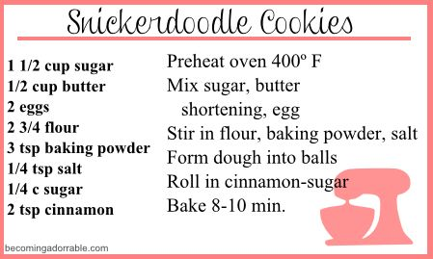
A recipe for snickerdoodles
Notes:
Start with a recipe analogy - if we want to complete a baking task, we need to A) get the ingredients and B) follow the steps EXACTLY and IN ORDER
We think like this for lots of tasks, not just cooking, but performing experimental analyses in the lab, etc.

Slide 3
Rosetta apps are recipes for molecular modeling
What are the ingredients?
What are the steps?
Lines of code
to use and manipulate
objects
Objects in the
Rosetta Libraries
Notes:
Rosetta is a recipe for molecular modeling - ask students questions:
What are the ingredients? - the objects in the Rosetta libraries
What are the steps? - Manipulations of objects
(Answers should appear in animation)

Slide 4
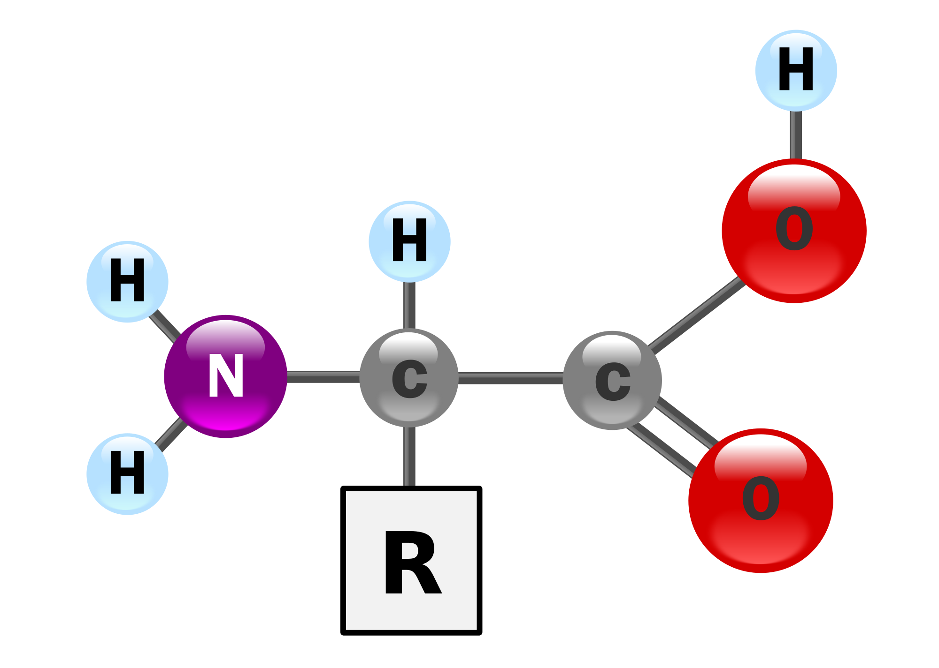
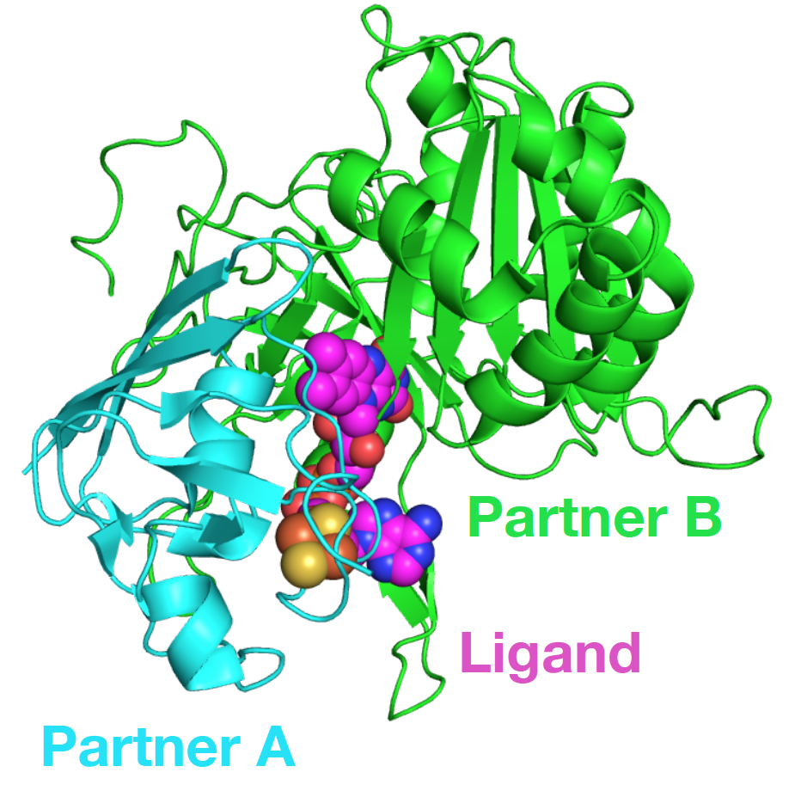
Writing the recipe: Ingredients
The central ingredient is the biomolecule
We call this object a Pose
Note - Cartoon representation approximates the
backbone
Notes:
What is the first ingredient? The molecular system of interest
Point out cartoon representation - convenient for showing the backbone position of the protein (CB-CA-N)
Why is the object not called protein? Rosetta can work with multiple proteins & ligands in a complex as shown here.
What do we need to “model” that ingredient using code?

Slide 5
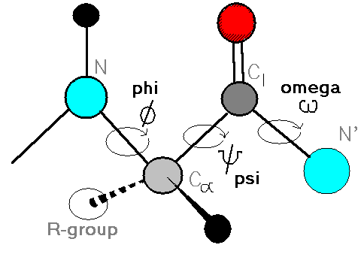
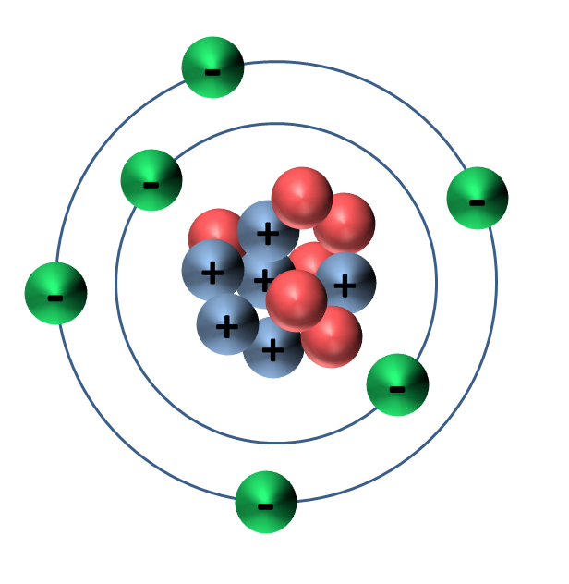
What makes a pose?
Smaller objects representing molecular conformation and energies are encapsulated in the Pose
Residue Types
Atom Types
Torsion Types
pose.residue(1)
pose.residue(1) .atom(“CA”)
pose.phi(1)
phose.psi(1)
pose.omega(1)

Slide 6
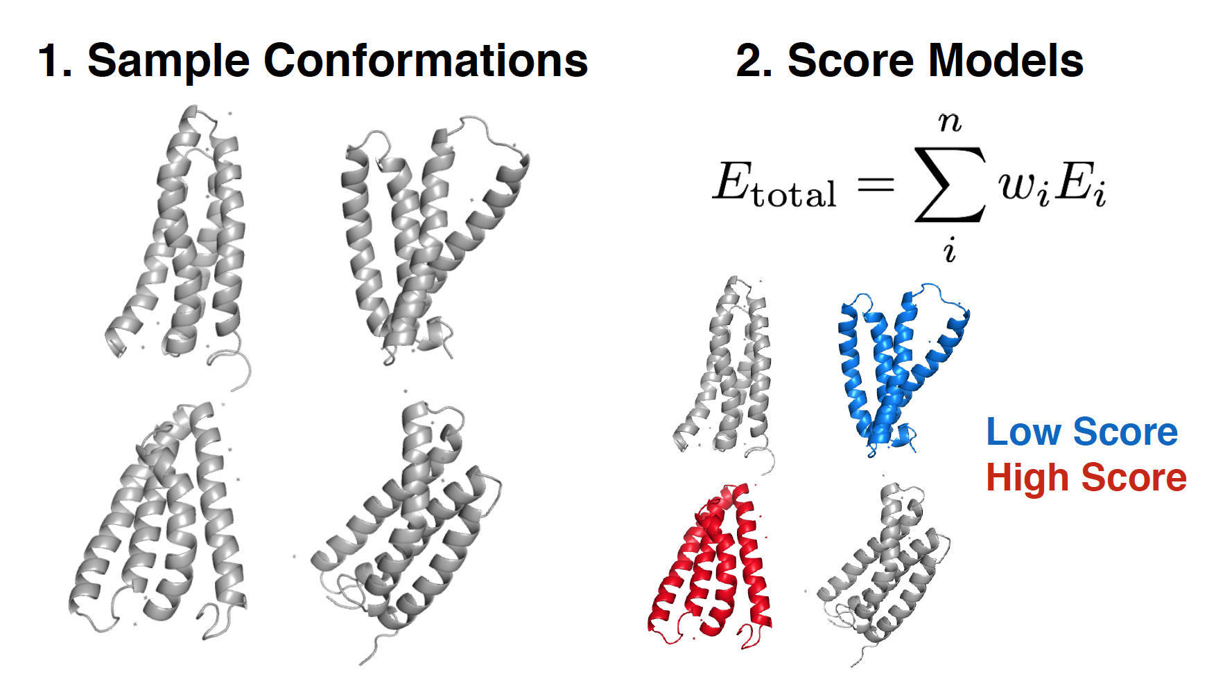
What are the steps?
In general, Rosetta apps follow the same recipe!

Slide 7
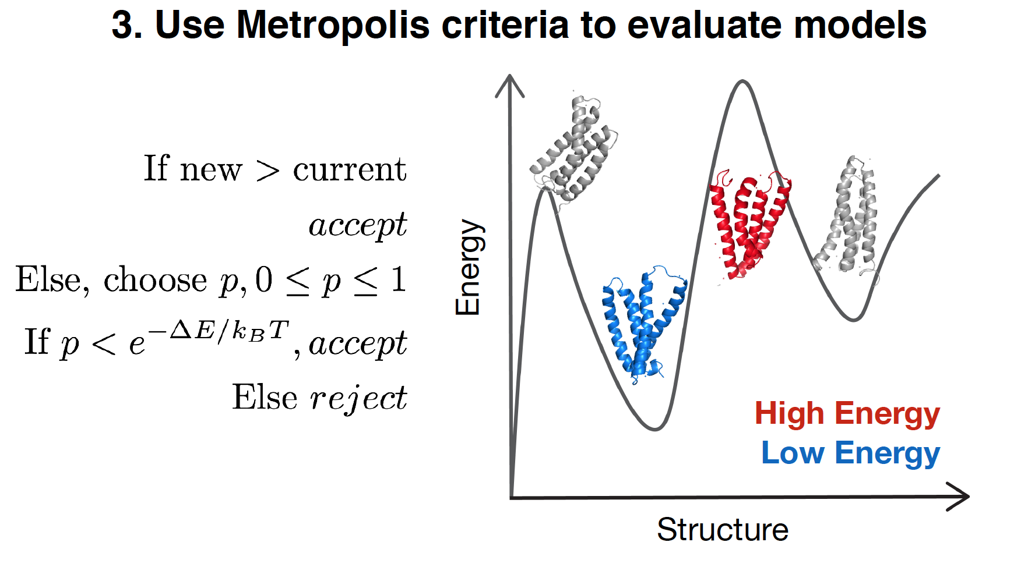
What are the steps?
In general, Rosetta apps follow the same recipe!
3. Evaluate the models

Slide 8
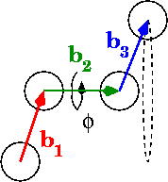
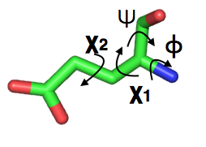
Basic Sampling: Changing torsions
Why do we use torsion angles instead of cartesian (XYZ) coordinates?
In proteins, bond angles & lengths relatively fixed
Physics!
4-body torsions very variable
3-body angles, &
2-body bond lengths less so

Slide 9
Basic Sampling: Changing torsions
Pose has accessors for all torsions!
void Pose::set_phi(
core::Size resnum, core::Real phi );
void Pose::set_psi(
core::Size resnum, core::Real psi );
void Pose::set_chi(
core::Size resnum,
core::Size chino, // Specific to side chain
core::Real chi
);
Notes:
Set phi/set psi change backbone torsion angles.

Slide 10
Basic Sampling: Changing torsions
Use a MoveMap to tell protocols what is allowed to move
using namespace core::kinematics;
MoveMapOP mm = new MoveMap();
Establishes a “level of flexibility” by limiting degrees of freedom
Can the side chains move? (chi angles)
Can the backbone (phi/psi) move?
mm.set_bb(true);
mm.set_chi(true);

Slide 11
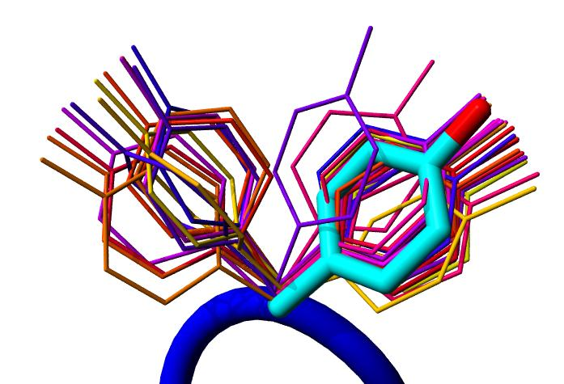
Many chi angles possible….
Packing: try different combinations of chi angles with statistical probabilities to find low energy orientations
core::pack::task::PackerTask: Bag of options for fine control of packing
Notes:
What can mutate, and to what?
What repacks?
Packing protocol style (temperature, cycles…)

Slide 12
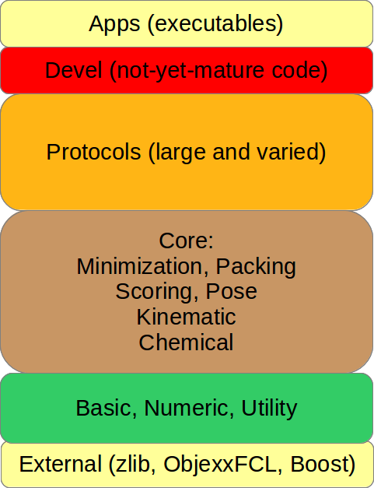
More complex sampling?
Later: Subclass protocols::moves...

Slide 13
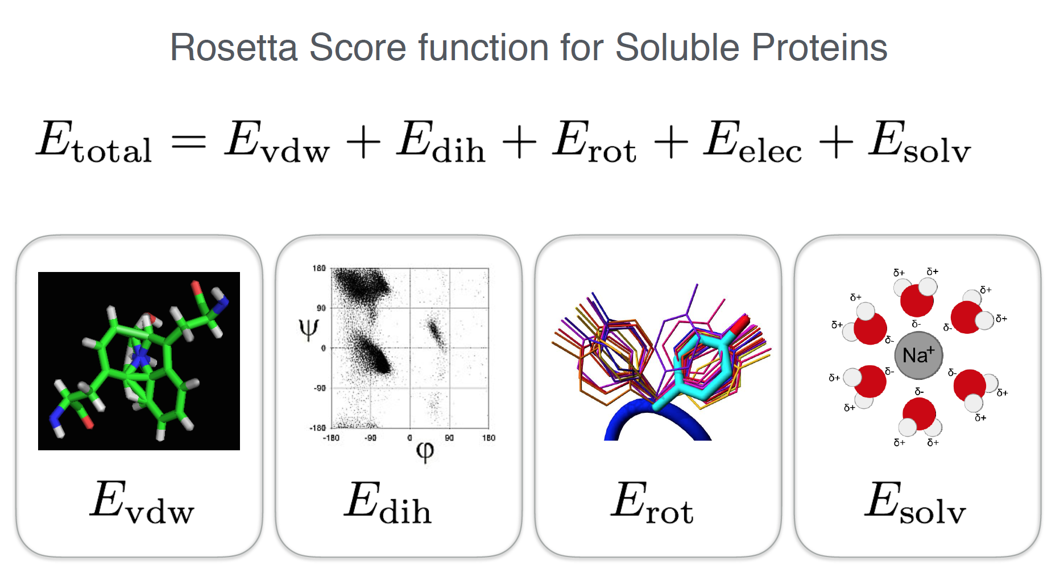
Scoring protein models
Notes:
Must say that there is a weight assigned to each term

Slide 14
The ScoreFunction Object
Lives in:
core::scoring
Scoring a Pose
sfxn->score(pose);
Accessing energies stored in the pose
pose.energies();
Want to see the energies?
pose.energies().show( std::cout );
*The score has no units (i.e. kCal/mol)

Slide 15
Evaluating models
Rosetta uses the metropolis criterion to
evaluate models - called Monte Carlo

Slide 16
MonteCarlo Object
Holds last accepted pose, new pose, and a scoring function
Compare score of last accepted pose to new conformation
MonteCarlo.boltzmann(pose) to evaluate
Notes:
Use the total energy of the pose (from the energy function/score function) to determine whether you should accept reject
Monte carlo object - what it holds

Slide 17
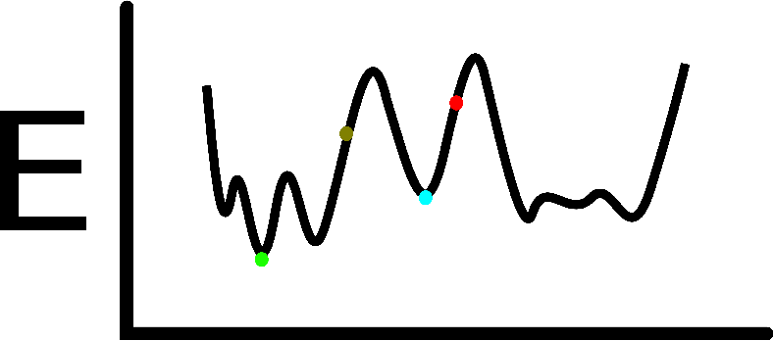
Finding low-energy structures
Broadly, YOU make the protocol
Metropolis Monte Carlo encourages most motions you try towards low energy
Packing uses very optimized algorithms to orient sidechains into low-energy arrangements
Minimization forces a pose down the local energy gradient

Slide 18
What happens when you pack?
Metropolis Monte Carlo again!
Simulated Annealing: temperature varies
e^[-(Enew-Eold)/kBT]
Notes:
how exactly do you pack - point this out in the backbone on this figure. Somewhat resembles

Slide 19
Minimization
Most score function terms have derivatives (calculus)
Code “knows” which way is low energy!
Minimizer moves pose to local minimum
Modifies degrees of freedom (DOFs)
4 body torsions
3 body angles
2 body lengths
Notes:
can be done in internal or cartesian coordinates (will discuss this later)

Slide 20
Break: Big Picture to Details
So far, how and why Rosetta does things
Now, Rosetta-specific details
“Rosetta-flavored” C++
compilation system
small parts of big systems needed for lab

Slide 21
Rosetta Types
Types to use in Rosetta (not C++ types) - platform compatible
core/types.hh
core::Size - platform::Size => unsigned integer
core::Real - platform::Real => double
core::Vector - numeric::xyzVector => (x, y, z)
Notes:
why would you use a core::Vector vs. a utility::vector1
useful methods in xyzVector (andrew will talk about this in more detail)

Slide 22
Command line options system
Access inputs from the command line:
#include <basic/options/keys/in.OptionKeys.gen.hh>
#include <basic/options/option.hh>
using namespace basic::options;
option[ OptionKeys::in::file::s ].value();
Specifying an option on the command line:
-in:file:s mystruct.pdb

Slide 23
Random Number Generators
Utility located in numeric/random/random.hh
Value in range [0,1):
double uniform(void);
double gaussian(void);
Integer in range [low, high]:
int random_range(int low, int high);

Slide 24
Writing a Pilot App
Executable from which you can run your code
int main( int argc, char * argv [] )
{
try {
devel::init(argc, argv);
// my code here
} catch ( utility::excn::EXCN_Base const & e ) {
std::cout << “Caught Exception << e.msg << std::endl;
return -1;
}
return 0;
}
Notes:
} catch ( utility::excn::EXCN_Base const & e ) {
std::cout << "caught exception " << e.msg() << std::endl;
return -1;

Slide 25
PyMol Viewer
Communication between Rosetta and PyMol - allows you to view and run your simulation
Setup:
(1) Add protocols::moves::AddPyMolObserver to
attach the PyMol observer to the pose (or use cmd-line options for JD2-based applications)
(2) In PyMol session, run
src/python/bindings/PyMOLPyRosettaServer.py
(3) Run your pilot app
More Documentation here!:
https://www.rosettacommons.org/docs/wiki/rosetta-basics/graphics-and-guis

Slide 26
Lab Overview
Create your own Rosetta Protocol
Load a pose
Score a pose
make random phi/psi perturbations
repack
minimize
MC accept/reject

